Slide 1
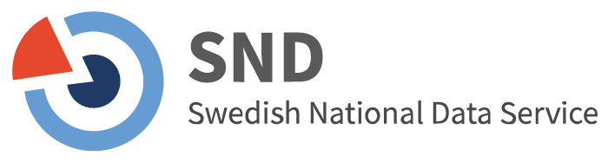
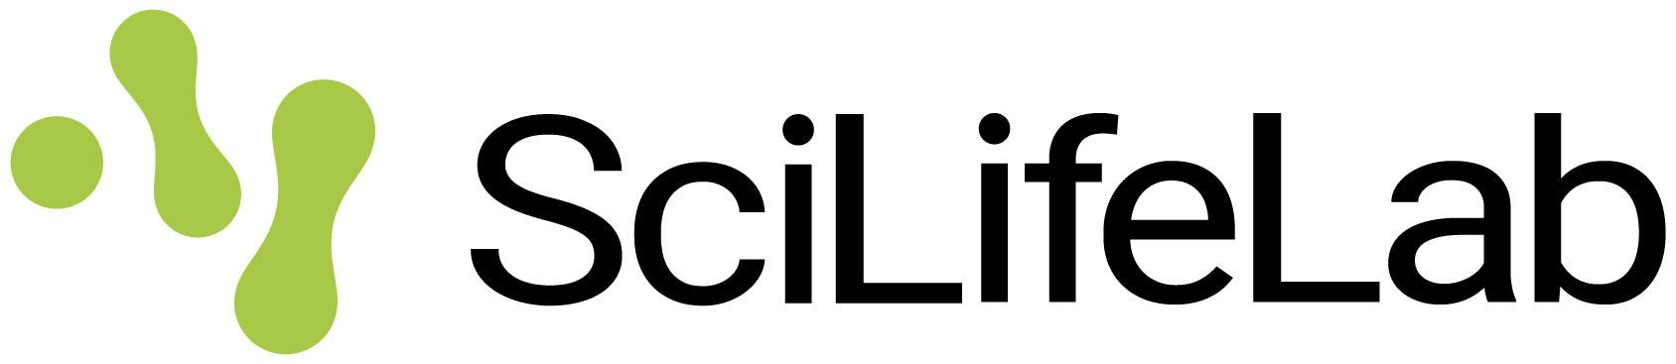
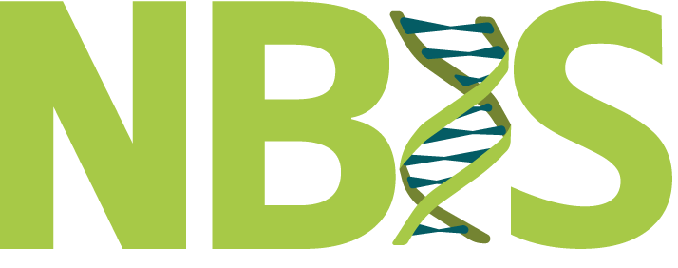

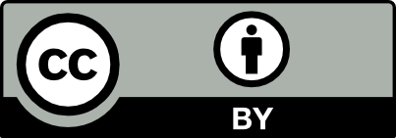
Open Science in the Swedish Context
04/05/2026
SciLifeLab Training Hub
Ineke Luijten, PhD
Notes:
Title: "Open Science in the Swedish Context"
Slides author:
name: "Ineke Luijten"
ORCID: 0000-0001-5768-275X
email: ineke.luijten@scilifelab.se
Part of: Open Science in the Swedish Context, SciLifeLab / NBIS / SND
Url: https://scilifelab-training.github.io/open-science/2605/day1.html
duration: 45 min

Slide 2
Welcome!

Slide 3
Learning Objectives
This course is designed for participants to:
→ Get acquainted with Open Science principles and how they will be implemented into Swedish academia within the coming years
→ Be able to execute every step of a research project according to Open Science principles
Learning Outcomes
Upon completion of this course, participants will be able to:
→ Explain what Open Science is, and discuss the benefits and challenges that come with its implementation, specifically in the Swedish context
→ Describe the most common Open Science practices throughout every step of the research project lifecycle
→ Implement Open Science practices into their own workflow
Notes:
Open Science, by its nature, is philosophical, it's not a fixed set of rules or a checklist to follow. There’s no universal formula that guarantees your research is fully "open" in every context. Instead, it's a mindset, a work in progress, and very much shaped by evolving practices, technologies, and policies.
This course isn’t about prescribing one right way to do Open Science. It’s designed to raise awareness of the current landscape, to show what’s out there, what’s possible, and what’s already being done.
The goal is to help you think critically about how to make your own research as open as possible, and as closed as necessary, recognizing that every project has different needs and constraints.
Policies are still being shaped, best practices are still emerging, and what works in one field or institution might not in another. So throughout the course, stay curious, ask questions, and think about how these principles can apply to your own work.

Slide 4
Practicalities
Emergency email: david.rayner@gu.se ineke.luijten@scilifelab.se
All content is/will be available at https://scilifelab-training.github.io/open-science/2605/
In case of fire: grass area across from main entrance
For course certificate, please email david.rayner@gu.se at the end of the course

Slide 5
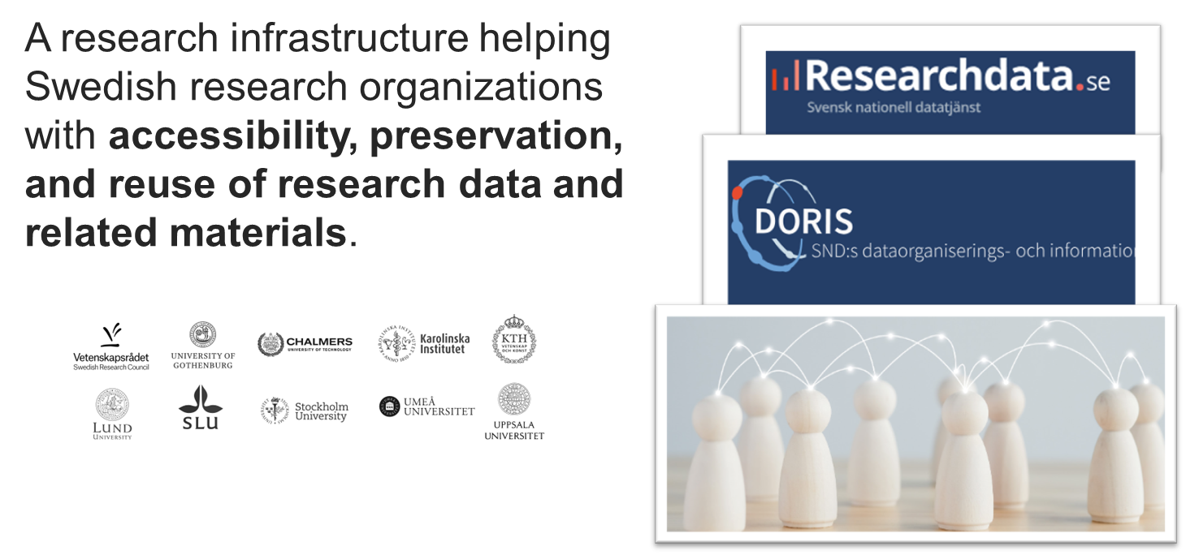
Who are we? - Swedish National Data service
Notes:
The Swedish National Data service - SND - is the national infrastructure responsible for helping Swedish research organizations with accessibility, preservation, and reuse of research data and related materials. SND provides
Researchdata.se, a national data portal offering integrated access to datasets from multiple repositories,
SND DORIS – a service for publishing and sharing datasets, and
the SND Network – a nationwide community promoting best practices in data management across institutions.

Slide 6
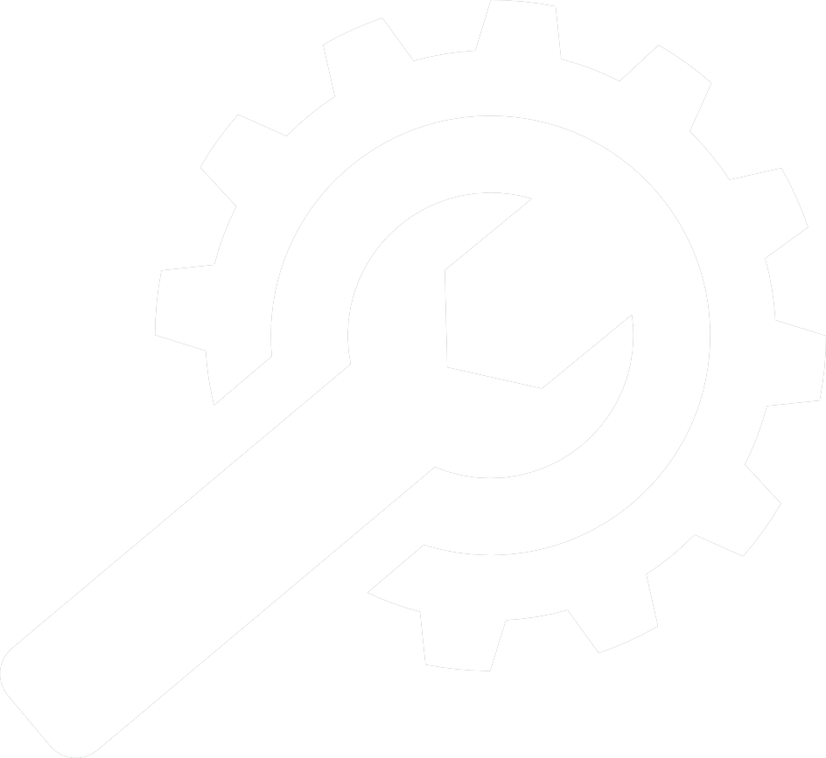




Who are we? - SciLifeLab Training Hub
Training Hub
Sustainable, cutting-edge, short-form training for technology- and data-driven life sciences
Infrastructure
Support
Training
SE and EU projects
Community-building
Building tools for consolidating and accessing FAIR Open Educational Resources
Establishing best practice in training design, development & delivery
In-house development of a catalogue of interdisciplinary short-form trainings
Linking SciLifeLab training to national and international organizations and initiatives
Upskilling the SciLifeLab community to enable excellence
Notes:
SciLifeLab is a national infrastructure for life science, which provides researchers in fields such as biomedicine, ecology, and evolution with access to advanced technologies and expertise
Training Hub mission: to capture an accessible, up-to-date Open and FAIR library of SciLifeLab knowledge to connect the life science community in Sweden with skills enabling cutting-edge, collaborative research. Supporting community access to SciLifeLab knowledge, skills, and expertise
Within the Training Hub, we are creating our support and services to the SciLifeLab community according to 5 pillars, namely infrastructure, support, training, SE/EU projects, and community building.
We provide the technical infrastructure with the Training Portal and other tools and resources that will help the trainers to design, develop and deliver training and the community to find and consume the training materials
We will have the pillar Support where we provide support to the SciLifeLab ecosystem,
The third pillar is Training and here we aim to grow a training catalogue aiming to develop the staff across SciLifeLab as a RI.
Training Hub is also involved, directly or via other entities at SciLifeLab, in various national and European projects.
Community building is an activity that is transversal across all that we do.
We are guided by Open Science and FAIR principles across all these pillars, and are uniquely positioned to further strengthen the implementation of Open Science and FAIR into the SciLifeLab community

Slide 7
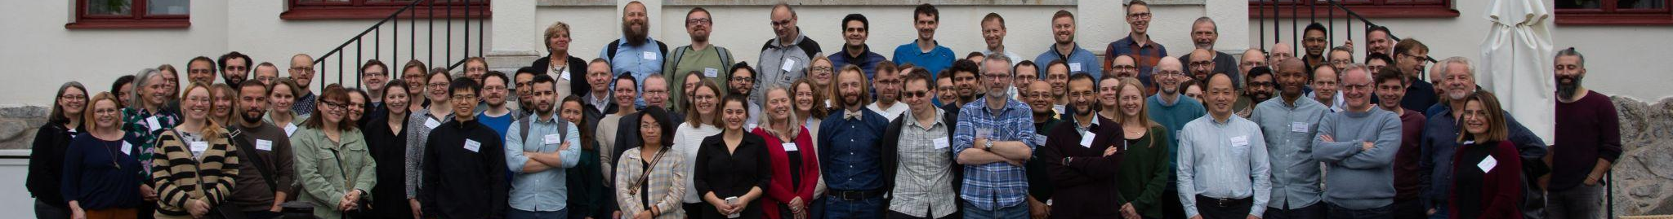
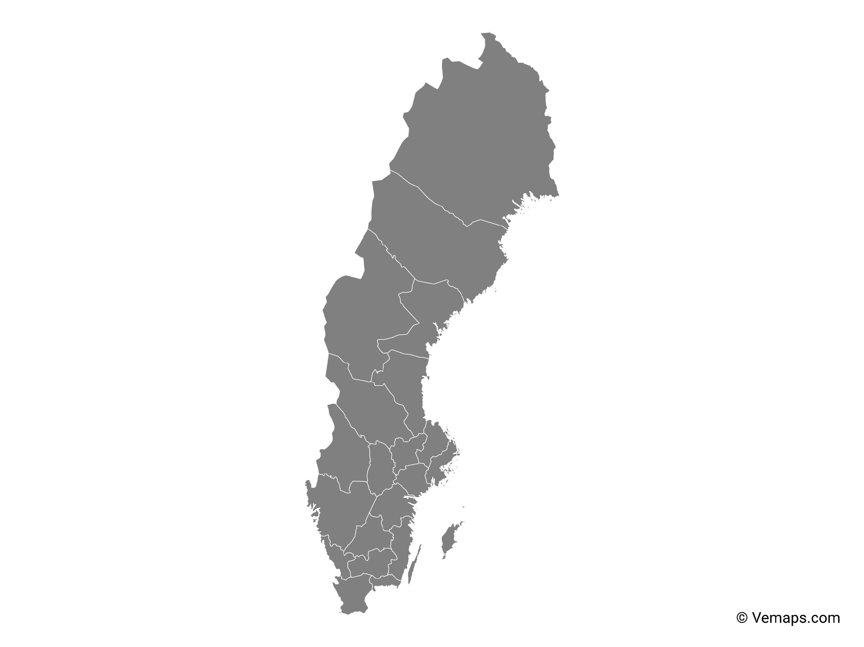

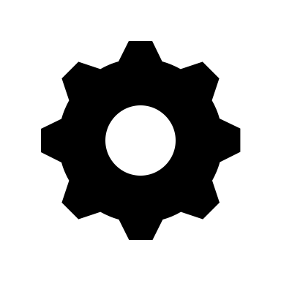

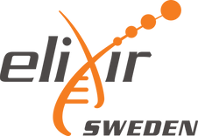
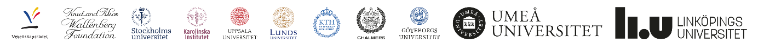
Who are we? - National Bioinformatics Infrastructure Sweden
‘To help the Swedish research community build knowledge in analyzing large and complex omics data and to make bioinformatics easily accessible for life science researchers’
NBIS.se
Support services ranging from short consultations to long-term embedded bioinformaticians.
Providing infrastructure in the form of services, computational resources, tools and guidelines to the life science community.
Training events in advanced and applied bioinformatics.
Support
Infrastructure
Training
Umeå
Uppsala
Stockholm
Göteborg
Linköping
Lund
Notes:
NBIS is a national research infrastructure and SciLifeLab’s bioinformatics platform as well as the Swedish node of ELIXIR - the European infrastructure for life sciences. We are a distributed infrastructure with staff at six locations in Sweden. We provide three core services in order to help the Swedish research community to build knowledge and make bioinformatics easily accessible for life science researchers. These are: - Support - individual support ranging from short consultations to embedded bioinformaticians - Infrastructure - computational tools, guidelines etc. - Training - short form training events and mentoring programmes at postgraduate level visit nbis.se to learn more

Slide 8
Who are you?
Name and affiliation
Research area
What interests you about Open Science?
One thing you hope to learn or take away from this course
What’s a hobby or activity you enjoy outside of work?
Notes:
15min

Slide 9
What is Open Science?
Notes:
To start the course, we first need to define what Open Science is. What words come to mind when you hear Open Science? What kind of practices are included in Open Science?
Perhaps you have already heard the term open science. You might have encountered it at your work or on social media. You might have heard good and bad things about it. But what does open science mean exactly?

Slide 10
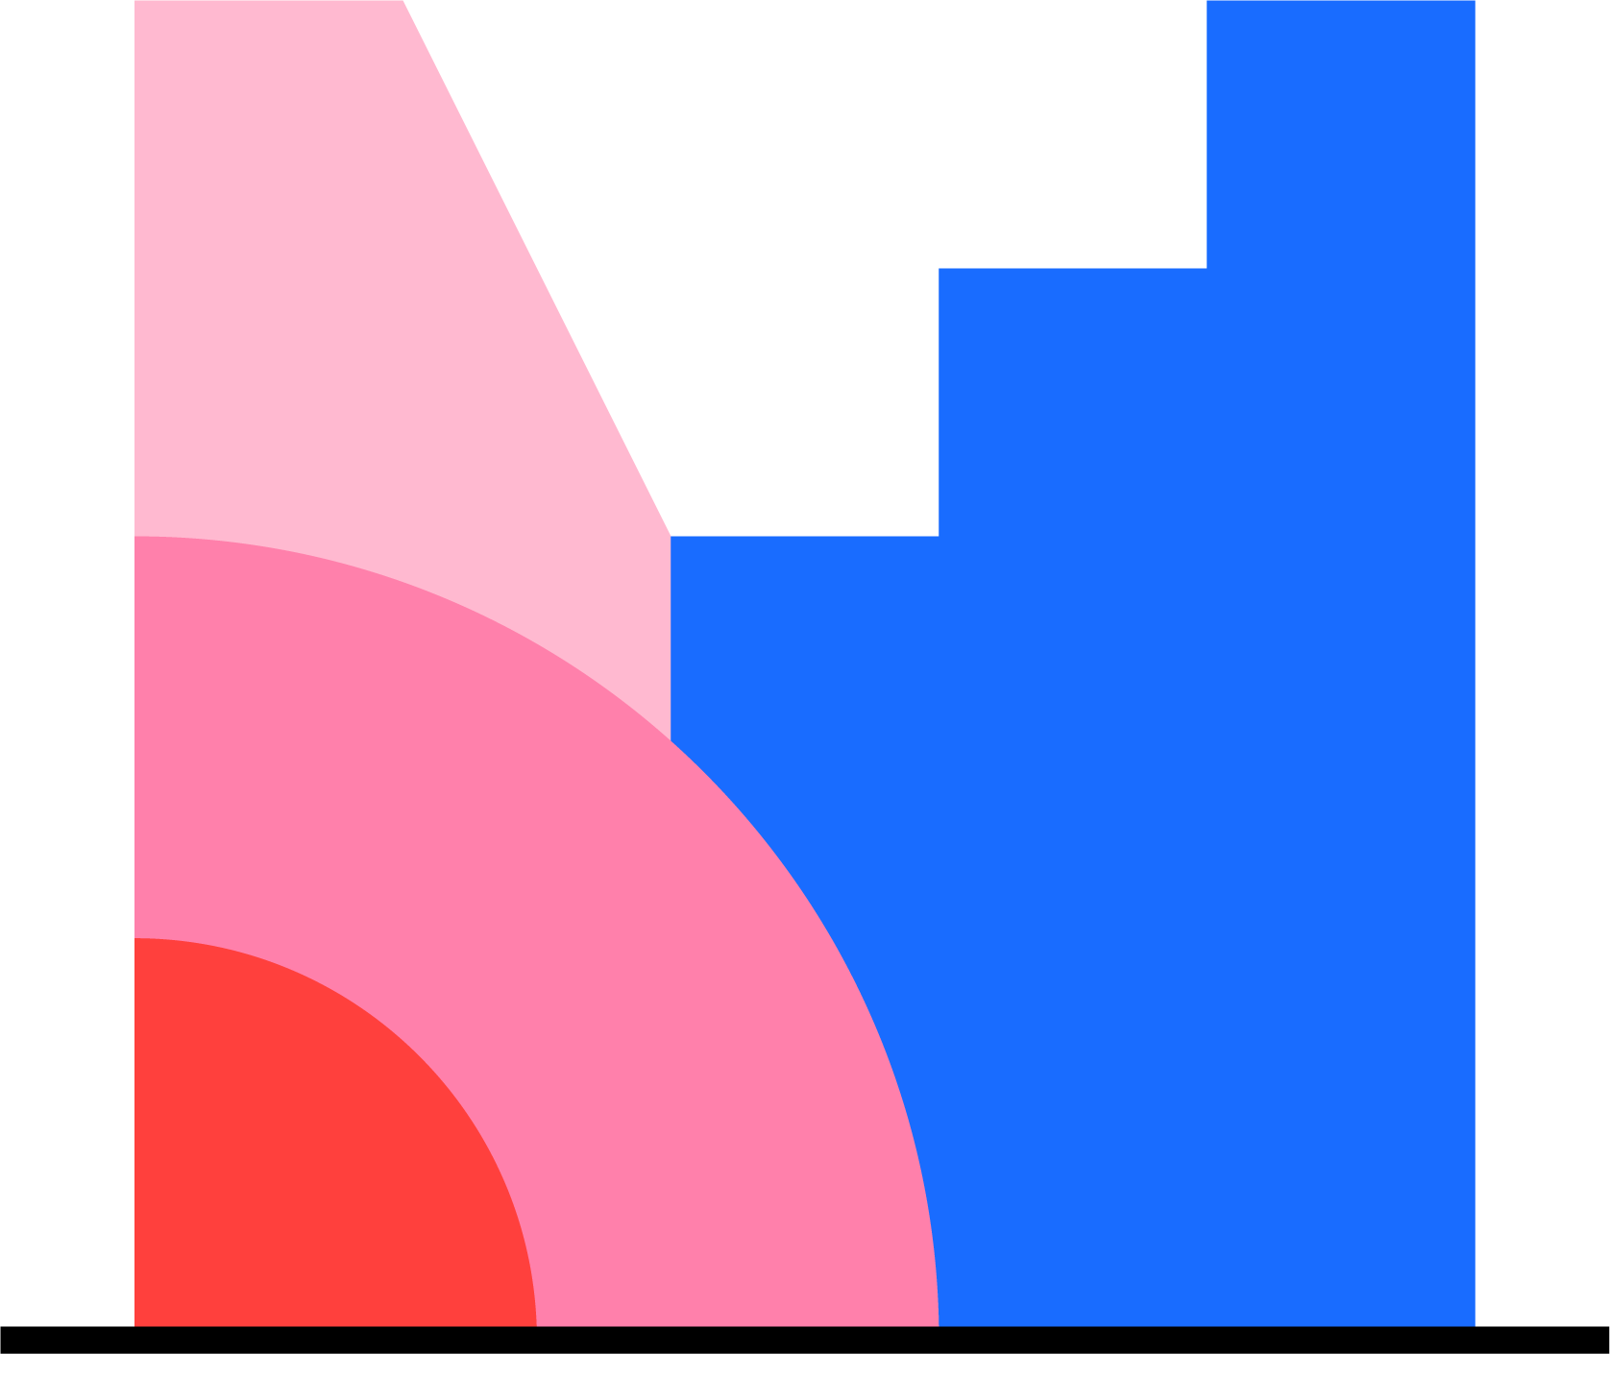
What is Open Science?
Mentimeter time!
Question:
Which words come to mind when you hear Open Science (wordcloud)
Notes:
To start the course, we first need to define what Open Science is. What words come to mind when you hear Open Science? What kind of practices are included in Open Science?
Perhaps you have already heard the term open science. You might have encountered it at your work or on social media. You might have heard good and bad things about it. But what does open science mean exactly?
What words come to mind when you hear Open Science?
What kind of practices are included?

Slide 11
What is Open Science?
“An inclusive construct that combines various movements and practices aiming:
to make multilingual scientific knowledge openly available, accessible, and reusable for everyone;
to increase scientific collaborations and sharing of information for the benefits of science and society;
to open the processes of scientific knowledge creation, evaluation, and communication to societal actors beyond the traditional scientific community.
It comprises all scientific disciplines and aspects of scholarly practices, including basic and applied sciences, natural and social sciences and the humanities”
UNESCO (2021) Recommendation on Open Science. https://doi.org/10.54677/MNMH8546. CC BY-SA 3.0 IGO
Notes:
2021 UNESCO recommendation on Open Science provides a framework with principles and approaches for creating globally equitable access to scientific results and research processes, aiming to accelerate the implementation of the global Sustainable Development Goals
From the recommendation (page 6):
“The aim of this Recommendation is to provide an international framework
for open science policy and practice that recognizes disciplinary and regional
differences in open science perspectives, takes into account academic
freedom, gender-transformative approaches and the specific challenges
of scientists and other open science actors in different countries and in
particular in developing countries, and contributes to reducing the digital,
technological and knowledge divides existing between and within countries.”
Open Science, as defined above, encompasses a huge number of potential structural changes to academic practice, whose culture can often be hierarchical and conservative. Moreover, even where researchers are sympathetic to the aims of Open Science, they might not yet see the worth in taking them up, as existing incentive mechanisms do not yet reflect this new culture of openness and collaboration.
Open science is an umbrella term that includes various movements with a common goal: to remove barriers to knowledge so that output, resources, methods, and tools can be freely shared and accessed by anyone at any stage of the research process. This means that adopting open science practices intrinsically favors collaboration, collectivism, and societal participation instead of individualism and career-oriented behavior.
Synonyms: you may also encounter terms like open research or open scholarship. That's because the basic principles of responsible openness and transparency apply not only to scientific disciplines, but any activity aimed at producing knowledge.

Slide 12
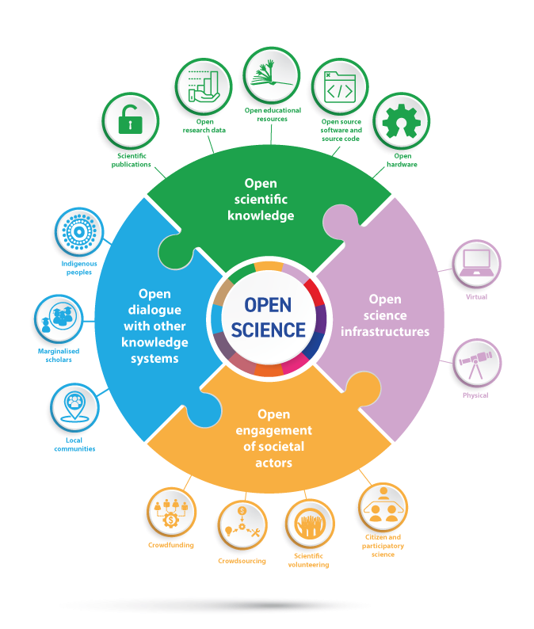
What is Open Science?
Free access to
❚ scientific publications (e.g. articles, books, research reports, conference papers),
❚ research data (digital or analogue, raw or processed, metadata, records, images, protocols, analysis codes, workflows, and more),
❚ educational resources (teaching, learning and research materials),
❚ open source software and source code
❚ open hardware, such as the design specifications of physical objects.
UNESCO (2022) Understanding Open Science. https://doi.org/10.54677/UTCD9302 CC BY-SA 3.0 IGO
Notes:
On the slide it shows the components of Open Scientific knowledge. It also refers to the possibility of opening research methodologies and evaluation processes.
Open science infrastructures refer to shared research infrastructures that are needed to support open science and serve the needs of different communities. Open science infrastructures can provide common access to physical facilities as well as essential open and standardized services and capabilities to manage and create access, portability, analysis and federation of data, scientific literature, thematic science priorities or community engagement. These infrastructures can be virtual or physical, including major scientific equipment, knowledge-based resources such as collections, journals and open access publication platforms, open bibliometrics and scientometrics systems for assessing and analyzing scientific domains. Open laboratories, digital research services, innovation incubators and science parks are among the many types of infrastructure components that can support open science
Open engagement of societal actors refers to extended collaboration between scientists and societal actors beyond the scientific community, by opening up practices and tools that are part of the research cycle and by making the scientific process more inclusive and accessible to the broader inquiring society. New forms of collaboration and work can be used, such as crowdfunding, crowdsourcing, scientific volunteering and citizen science. Open science provides the basis for citizens and communities to be involved in the generation of knowledge and shared problem-solving. Open science allows for an enhanced dialogue between scientists, policymakers and practitioners, entrepreneurs and community members, giving all stakeholders a voice in developing research that is compatible with their concerns, needs and aspirations
Open dialogue with other knowledge systems refers to the dialogue between different knowledge holders, that recognizes the richness of diverse knowledge systems and epistemologies and diversity of knowledge producers, in line with the 2001 UNESCO Universal Declaration on Cultural Diversity. Open dialogue aims to:
-promote the inclusion of knowledge from traditionally marginalized scholars and
-enhance - inter-relationships and complementarities between diverse epistemologies
- adherence to international human rights norms and standards
- respect for knowledge sovereignty and governance
- recognition of the rights of knowledge holders to receive a fair and equitable share of benefits that may arise from the use of their knowledge.
In particular, links with indigenous knowledge systems must be built in line with the 2007 United Nations Declaration on the Rights of Indigenous Peoples and principles for Indigenous Data Governance, such as the CARE (Collective Benefit, Authority to Control, Responsibility and Ethics) data principles. Such efforts acknowledge the rights of indigenous peoples and local communities to govern and make decisions on the custodianship, ownership and administration of data on traditional knowledge and on their lands and resources.

Slide 13
Open Science - How did we get here?
Notes:
So now we have a working definition of Open Science, what it is and what it aims to do. But to really understand why Open Science matters, it helps to know where it came from. Because Open Science isn’t a brand-new concept, it’s the result of decades, even centuries, of evolving ideas about how knowledge should be created, shared, and used. The push for openness didn’t happen overnight. It was shaped by moments of crisis, technological changes, and growing public demand for access to research, especially when it's publicly funded. Let’s take a quick look at how we got here.

Slide 14
Open Science - How did we get here?
Year
1600
1700
1800
1900
2000
2100
Pre-1600
1600-1660
1660-1700
1700-1900
1900-1950
Secrecy is Power
Aristocratic patronage
Scientific societies and publications
Limited access
Mertonian norms
natural philosophers, alchemists and craft guilds kept discoveries secret to create monopolies focused on maximizing profit
science funded by aristocrats who needed help with solving practical problems and wanted to enhance their reputation
- patrons incentivized knowledge-sharing to avoid funding charlatans and enhance the reputation of their protégé
- research pooled into academies funded by multiple patrons : Royal Society of London (1660) & Académie Royale des Sciences (1666)
- birth of the academic journal: Journal des savants (1665) & Philosophical Transactions of the Royal Society (1665)
- Increased scientific output: publication and peer-review becomes routine
- Journals expensive, access is limited
Communism
Universalism
Disinterestedness
Organized skepticism
Notes:
In the pre-modern era (Middle Ages + start of Renaissance), the sharing of scientific knowledge was rare and often discouraged. Knowledge production took place in fragmented communities, such as natural philosophers, alchemists, and craft guilds, each with their own motives for keeping discoveries secret.
1. Knowledge as Trade Secret
Alchemists and early practitioners of what we now consider science often encoded their findings in cryptic language or symbolism, aiming to protect their intellectual property and avoid scrutiny.
Craft guilds in fields like metallurgy, glassmaking, or dyeing treated techniques as closely guarded secrets, passed down through apprenticeships. This secrecy preserved economic monopolies and competitive advantage.
2. Patronage and Elitism
Many scholars relied on the support of aristocratic or ecclesiastical patrons. Knowledge was a personal asset, not something shared openly but used to gain favor, prestige, or positions.
Sharing too widely could jeopardize one’s social standing or diminish the value of one's discovery.
3. Absence of Formal Institutions
With no universities focused on empirical science and no standardized publishing or peer review, there were few incentives to share findings openly.
The idea of science as a collaborative or cumulative effort had not yet taken hold.

Slide 15
Open Science - How did we get here?
Year
1600
1700
1800
1900
2000
2100
Pre-1600
1600-1660
1660-1700
1700-1900
1900-1950
Secrecy is Power
Aristocratic patronage
Scientific societies and publications
Limited access
Mertonian norms
natural philosophers, alchemists and craft guilds kept discoveries secret to create monopolies focused on maximizing profit
science funded by aristocrats who needed help with solving practical problems and wanted to enhance their reputation
- patrons incentivized knowledge-sharing to avoid funding charlatans and enhance the reputation of their protégé
- research pooled into academies funded by multiple patrons : Royal Society of London (1660) & Académie Royale des Sciences (1666)
- birth of the academic journal: Journal des savants (1665) & Philosophical Transactions of the Royal Society (1665)
- Increased scientific output: publication and peer-review becomes routine
- Journals expensive, access is limited
Communism
Universalism
Disinterestedness
Organized skepticism
Notes:
Between 1600 and 1660, the culture of scientific sharing began to shift in Europe as aristocratic patronage became a dominant force. Kings, dukes, and other elites funded scientists to solve practical problems (e.g. improving agricultural yields or navigation) which served both economic and political goals. While secrecy still prevailed to ensure that prestige remained with the patron, reputation increasingly became a valuable asset for scientists. To attract support and distinguish themselves from charlatans, researchers began sharing their findings selectively, initiating a slow move toward openness as a means of gaining credibility and recognition within elite circles.

Slide 16
Open Science - How did we get here?
Year
1600
1700
1800
1900
2000
2100
Pre-1600
1600-1660
1660-1700
1700-1900
1900-1950
Secrecy is Power
Aristocratic patronage
Scientific societies and publications
Limited access
Mertonian norms
natural philosophers, alchemists and craft guilds kept discoveries secret to create monopolies focused on maximizing profit
science funded by aristocrats who needed help with solving practical problems and wanted to enhance their reputation
- patrons incentivized knowledge-sharing to avoid funding charlatans and enhance the reputation of their protégé
- research pooled into academies funded by multiple patrons : Royal Society of London (1660) & Académie Royale des Sciences (1666)
- birth of the academic journal: Journal des savants (1665) & Philosophical Transactions of the Royal Society (1665)
- Increased scientific output: publication and peer-review becomes routine
- Journals expensive, access is limited
Communism
Universalism
Disinterestedness
Organized skepticism
Notes:
Between 1660 and 1700, the growth of scientific inquiry began to exceed what aristocratic patronage alone could sustain. As more individuals engaged in scientific pursuits, the demand for funding, recognition, and intellectual exchange outpaced the capacity and interests of individual patrons. Aristocratic support was often inconsistent, tied to personal tastes or political motives, and limited to a small number of protégés. This created the need for more stable and collective forms of support, leading to the establishment of formal scientific societies such as the Royal Society of London in 1660 and the Académie Royale des Sciences in Paris in 1666. Between the 1660s and 1793, governments gave official recognition to 70 other scientific organizations modeled after those two academies. These institutions were designed to pool resources, coordinate research, and create spaces where scientists could exchange knowledge in a more structured and reliable way.
At the same time, sharing scientific work became increasingly important as a means of establishing credibility and attracting institutional support. Informal peer review practices emerged as a solution to help patrons and societies assess the quality and authenticity of scientific claims. Membership in these societies became prestigious, offering access to valuable networks and information. Scientists were expected to contribute to collective knowledge, which encouraged a shift from secrecy to openness. This transformation was reflected in new forms of scientific communication, most notably the founding of Europe’s first academic journals, Journal des sçavans and Philosophical Transactions in 1665. These publications marked a key moment in the institutionalization of science, laying the foundation for modern scientific publishing and the norms of transparency and collaboration that define Open Science today. By 1699 there were 30 scientific journals; by 1790 there were 1052.

Slide 17
Open Science - How did we get here?
Year
1600
1700
1800
1900
2000
2100
Pre-1600
1600-1660
1660-1700
1700-1900
1900-1950
Secrecy is Power
Aristocratic patronage
Scientific societies and publications
Limited access
Mertonian norms
natural philosophers, alchemists and craft guilds kept discoveries secret to create monopolies focused on maximizing profit
science funded by aristocrats who needed help with solving practical problems and wanted to enhance their reputation
- patrons incentivized knowledge-sharing to avoid funding charlatans and enhance the reputation of their protégé
- research pooled into academies funded by multiple patrons : Royal Society of London (1660) & Académie Royale des Sciences (1666)
- birth of the academic journal: Journal des savants (1665) & Philosophical Transactions of the Royal Society (1665)
- Increased scientific output: publication and peer-review becomes routine
- Journals expensive, access is limited
Communism
Universalism
Disinterestedness
Organized skepticism
Notes:
Between 1700 and 1900, the sharing of scientific knowledge became increasingly formalized through the growing publication of scientific journals. Building on the foundations laid by 17th-century academies, journals became a central platform for disseminating research, enabling scientists to communicate discoveries, establish priority, and engage in scholarly critique. During the 18th century alone, over a thousand journals were established (though many were short-lived) reflecting both the expanding interest in science and the fragmented nature of early scholarly publishing.
This period also saw the gradual institutionalization of peer review, providing a mechanism for quality control and credibility. However, despite this increased output, access to journals remained limited. High subscription costs and restricted distribution meant that scientific communication was largely confined to elite institutions and well-connected scholars, reinforcing existing hierarchies in knowledge production. Nonetheless, this era laid crucial groundwork for modern scientific communication, fostering the norms of public disclosure, replication, and cumulative knowledge that would later underpin the open science movement.
Swedish context:
Dating back to 1766, Sweden’s Freedom of the Press Act guarantees public access to official documents. This principle heavily influenced the country’s academic culture, fostering expectations that public knowledge, including research, should be openly accessible. The Swedish Freedom of the Press Ordinance of 1766 is now inscribed on the UNESCO Memory of the World Register. The first of its kind in the world, the Ordinance includes both the rights of freedom of expression and that of access to official public records.

Slide 18
Open Science - How did we get here?
Year
1600
1700
1800
1900
2000
2100
Pre-1600
1600-1660
1660-1700
1700-1900
1900-1950
Secrecy is Power
Aristocratic patronage
Scientific societies and publications
Limited access
Mertonian norms
natural philosophers, alchemists and craft guilds kept discoveries secret to create monopolies focused on maximizing profit
science funded by aristocrats who needed help with solving practical problems and wanted to enhance their reputation
- patrons incentivized knowledge-sharing to avoid funding charlatans and enhance the reputation of their protégé
- research pooled into academies funded by multiple patrons : Royal Society of London (1660) & Académie Royale des Sciences (1666)
- birth of the academic journal: Journal des savants (1665) & Philosophical Transactions of the Royal Society (1665)
- Increased scientific output: publication and peer-review becomes routine
- Journals expensive, access is limited
Communism
Universalism
Disinterestedness
Organized skepticism
Notes:
Between 1900 and 1950, the norms surrounding the sharing of scientific knowledge became more explicitly tied to ideals of public service and ethical conduct as science grew increasingly professionalized, and institutionalized. Universities and state institutions became central to research, particularly as scientific knowledge began playing a pivotal role in industrial innovation, agriculture, public health, and national defense. With this growth came efforts to define what it meant to be a responsible and ethical member of the scientific community.
In the 1940s, sociologist Robert K. Merton articulated a foundational set of principles, known as the Mertonian norms, that helped define modern scientific ethos.
These include:
- communism (the idea that scientific knowledge should be shared collectively)
- universalism (scientific claims are judged independently of the personal attributes of the researcher)
- disinterestedness (research should be pursued for the collective good, not personal gain)
- organized skepticism (claims must undergo critical peer evaluation).
These norms helped formalize the expectation that science operates in the public interest and should remain open, transparent, and collaborative. They continue to influence international standards for research integrity today, reinforcing openness as a core element of credible scientific practice.

Slide 19
Open Science - How did we get here?
Year
1600
1700
1800
1900
2000
2100
1950-1990
1990-2000
2000-2010
2010-2020
2020-...
Public funding, private publishing
The rise of the internet
Transformation
Paradigm shifts and policy
Global change and rewards
Post WWII: rise of large-scale, government-funded science programs, ‘Golden Age of Science’
Some scientific journals no longer funded by scientific societies or universities, but by for-profit publishers
Digital publishing is born with the 1991 launch of arXiv
First Open Access journals emerged: authors paid, readers could access content freely.
Budapest Open Access Initiative, Bethesda Statement, Berlin Declaration
PLOS founded, PubMed Central launched, Creative Commons licenses introduced, university repositories set up
Beginning of open data and OER
Open Access mandates by funders - Plan S
Introduction of FAIR data principles and data management plans
preprint servers, OERs, citizen science, and altmetrics
UNESCO recommendations
CoARA launched
- publication and peer-review becomes routine
- journals expensive, access is limited
Notes:
World War II played a major role in shaping modern science (especially through the Manhattan Project) which demonstrated the strategic value of scientific research and triggered the rise of large-scale, government-funded science programs in its aftermath. Governments began to heavily invest in research and development (eg in areas like physics, medicine, and space exploration) seen as essential for national progress, innovation, and public good. This led to the development of major funding agencies like the NSF (USA), ERC (EU), and others.
This ushered in what some call the "Golden Age of Science", characterized by unprecedented funding levels, the expansion of universities, and a boom in scientific output. Yet despite this public investment, the dissemination of research increasingly became privatized.
During this time, commercial academic publishers began to consolidate power. Scientific journals, which had previously been run by scientific societies or universities, were increasingly managed by for-profit publishers. The model shifted: researchers submitted work for free (often giving up copyright), peer-reviewed for free, and readers, or more often, their institutions, had to pay increasing subscription fees to access the work. This model resulted in what many consider a fundamental contradiction: taxpayer-funded research locked behind expensive paywalls.
The imbalance sparked early criticism. The idea that public knowledge was being commodified clashed with the Mertonian ideals that were still taught as the ethical foundation of science. Moreover, as the Cold War intensified, so did global scientific competition, which led to increasing pressures on researchers to publish more ("publish or perish") and protect their data, often at the expense of collaboration.
Yet seeds of resistance were also planted during this time. The development of early computing and the internet in the latter half of the century began to inspire new ways of thinking about knowledge sharing. By the end of the 1980s, conversations about digital repositories, preprints, and open access models were beginning to take shape.
Swedish context:
The national union catalogue Libris was introduced in 1972. This marked the beginning of the digitisation of Swedish libraries. These early digital infrastructures anticipated the broader move toward accessible digital scholarship.
Public funders like the Swedish Research Council (Vetenskapsrådet) and Riksbankens Jubileumsfond began developing policies promoting the dissemination of publicly funded research, although not yet formalized as Open Access.

Slide 20
Open Science - How did we get here?
Year
1600
1700
1800
1900
2000
2100
1950-1990
1990-2000
2000-2010
2010-2020
2020-...
Public funding, private publishing
The rise of the internet
Transformation
Paradigm shifts and policy
Global change and rewards
Post WWII: rise of large-scale, government-funded science programs, ‘Golden Age of Science’
Some scientific journals no longer funded by scientific societies or universities, but by for-profit publishers
Digital publishing is born with the 1991 launch of arXiv
First Open Access journals emerged: authors paid, readers could access content freely.
Budapest Open Access Initiative, Bethesda Statement, Berlin Declaration
PLOS founded, PubMed Central launched, Creative Commons licenses introduced, university repositories set up
Beginning of open data and OER
Open Access mandates by funders - Plan S
Introduction of FAIR data principles and data management plans
preprint servers, OERs, citizen science, and altmetrics
UNESCO recommendations
CoARA launched
- publication and peer-review becomes routine
- journals expensive, access is limited
Notes:
The 1990s marked a turning point for science communication, driven by the rapid development of the internet and digital publishing. Researchers began exploring new ways to disseminate findings outside the traditional, subscription-based journal system, ushering in what would soon become the Open Access movement.
A key milestone came in 1991, with the launch of arXiv, an online preprint server for physics (later expanding to other fields like mathematics and computer science). Created by Paul Ginsparg, arXiv allowed researchers to share their work immediately and freely, without waiting months for peer review and journal publication. This model empowered the scientific community to take back control over access and speed, encouraging a culture of openness and rapid dissemination.
Meanwhile, dissatisfaction with the high costs of journal subscriptions (often termed the “serials crisis”) intensified. Libraries, especially in public institutions and the Global South, struggled to afford journal packages from major commercial publishers. Despite the increasing digitization of publishing, paywalls remained the norm, and the gap widened between the ideals of public knowledge and the reality of restricted access.
In response, a wave of activism and experimentation began. Open-access journals like the Journal of Medical Internet Research (founded in 1999) and BioMed Central (launched in 2000) demonstrated alternative publishing models where authors (or funders) paid for publication, but readers could access content freely. These pioneers helped set the stage for the formalization of Open Access principles in the following decade.
By the end of the 1990s, it became increasingly clear that the technology to democratize science existed, what was needed next was coordinated action, infrastructure, and cultural change. This set the stage for the 2002 Budapest Open Access Initiative, a defining moment in the Open Access movement.

Slide 21
Open Science - How did we get here?
Year
1600
1700
1800
1900
2000
2100
1950-1990
1990-2000
2000-2010
2010-2020
2020-...
Public funding, private publishing
The rise of the internet
Transformation
Paradigm shifts and policy
Global change and rewards
Post WWII: rise of large-scale, government-funded science programs, ‘Golden Age of Science’
Some scientific journals no longer funded by scientific societies or universities, but by for-profit publishers
Digital publishing is born with the 1991 launch of arXiv
First Open Access journals emerged: authors paid, readers could access content freely.
Budapest Open Access Initiative, Bethesda Statement, Berlin Declaration
PLOS founded, PubMed Central launched, Creative Commons licenses introduced, university repositories set up
Beginning of open data and OER
Open Access mandates by funders - Plan S
Introduction of FAIR data principles and data management plans
preprint servers, OERs, citizen science, and altmetrics
UNESCO recommendations
CoARA launched
- publication and peer-review becomes routine
- journals expensive, access is limited
Notes:
The 2000s marked a decade of transformation, where the vision of open and equitable access to research gained formal definition, institutional backing, and grassroots momentum.
A defining moment came in 2002 with the Budapest Open Access Initiative (BOAI), which coined the term "Open Access" in its modern sense. Funded by the Open Society Foundations, the BOAI called for free and unrestricted online access to scholarly literature. It proposed two primary strategies:
Self-archiving (green open access)
Open-access journals (gold open access)
This was quickly followed by the Bethesda Statement (2003) and the Berlin Declaration (2003), both of which solidified Open Access principles and drew support from major research institutions and funding bodies worldwide.
At the same time, new open access publishers emerged. Public Library of Science (PLOS), founded in 2001 and launching its first journal in 2003, was a game-changer, combining rigorous peer review with fully open access content. PLOS helped legitimize open-access publishing and demonstrated that quality and openness could coexist.
In parallel, institutional repositories like PubMed Central (launched in 2000) offered centralized, free access to biomedical research. Universities began creating their own open repositories to house the work of their scholars, and mandates started emerging that required researchers to deposit their papers.
However, tensions were rising. Commercial publishers pushed back, raising concerns about sustainability, peer review, and prestige. Open Access advocates responded with new tools and metrics to challenge traditional journal hierarchies, sowing the seeds for the later push for reform in academic evaluation systems.
Meanwhile, the Creative Commons license was introduced in 2002, providing a legal framework to clearly signal how others could reuse scholarly work, a cornerstone of Open Science. The idea of open access to scientific publications quickly became inseparable from the question of free licenses to guarantee the right to disseminate and possibly modify shared documents, such as the Creative Commons licenses, created in 2002. In 2011, a new text from the Budapest Open Initiative explicitly refers to the relevance of the CC-BY license to guarantee free dissemination and not only free access to a scientific document.
This decade also saw the beginnings of open data and open educational resources (OER) movements, which expanded the concept of openness beyond just articles.
By the end of the decade, Open Access had gone from niche idea to a global norm-in-the-making, gaining recognition among funders (like the NIH), universities, and early adopter scientists. Yet challenges remained: entrenched academic reward systems still prioritized prestige journals, and paywalls were far from gone.
Swedish context:
The SUHF was among the early signatories of the Berlin Declaration on Open Access to Knowledge in the Sciences and Humanities (2004), a major milestone aligning Sweden with global Open Access principles.
The Swedish National Library developed SwePub (2009), a centralized database for collecting publication metadata from Swedish universities. It became a key tool for monitoring research output and supporting Open Access tracking.
Universities like Uppsala University, Lund, and Karolinska Institutet launched institutional repositories, encouraging researchers to archive their publications.
Some universities began to adopt internal Open Access mandates, or at least encouragements, anticipating the national policies that would emerge later.
The National Library of Sweden was given responsibility for coordinating Open Access efforts nationally, including tracking OA policies, publication output, and negotiating with publishers.
Sweden began participating in EU Framework Programmes (FP6, FP7) which increasingly promoted open access to research results, both data and publications.
Swedish ELIXIR Node was formed toward the end of this period, preparing to take a more structured approach to data openness and training in life sciences.

Slide 22
Open Science - How did we get here?
Year
1600
1700
1800
1900
2000
2100
1950-1990
1990-2000
2000-2010
2010-2020
2020-...
Public funding, private publishing
The rise of the internet
Transformation
Paradigm shifts and policy
Global change and rewards
Post WWII: rise of large-scale, government-funded science programs, ‘Golden Age of Science’
Some scientific journals no longer funded by scientific societies or universities, but by for-profit publishers
Digital publishing is born with the 1991 launch of arXiv
First Open Access journals emerged: authors paid, readers could access content freely.
Budapest Open Access Initiative, Bethesda Statement, Berlin Declaration
PLOS founded, PubMed Central launched, Creative Commons licenses introduced, university repositories set up
Beginning of open data and OER
Open Access mandates by funders - Plan S
Introduction of FAIR data principles and data management plans
preprint servers, OERs, citizen science, and altmetrics
UNESCO recommendations
CoARA launched
- publication and peer-review becomes routine
- journals expensive, access is limited
Notes:
The 2010s were a defining decade where Open Science expanded far beyond open access publishing, evolving into a comprehensive movement encompassing open data, open software, reproducibility, transparency, and research integrity. It was no longer just about access, it was about reimagining how science is done and shared.
Major Policy Pushes
In 2013, the White House Office of Science and Technology Policy (OSTP) directed U.S. federal agencies to make publicly funded research publicly available — a watershed moment that inspired similar actions globally.
The European Commission followed suit with open access mandates under Horizon 2020, the EU’s flagship funding program.
Most notably, in 2018, Plan S was launched by cOAlition S, a group of major funders. Plan S mandated that all research funded by its members be published in compliant open access journals or platforms by 2021. This marked a bold shift in policy enforcement around Open Access.
FAIR Principles and Research Data
The FAIR data principles (Findable, Accessible, Interoperable, Reusable) were introduced in 2016 to guide proper management of scientific data. This put open data squarely on the policy agenda, recognizing that publications alone were not enough — the underlying data had to be reusable and well-described.
Funders and institutions began requiring data management plans (DMPs), and infrastructures like Zenodo, Figshare, and Dryad made data sharing more feasible.
The Rise of Preprints and Alternative Models
The use of preprint servers exploded. While arXiv had been around since the 1990s, the 2010s saw the emergence of bioRxiv (2013) and medRxiv (2019), enabling life sciences and medical researchers to share findings before peer review.
This challenged the traditional journal model, emphasizing speed, openness, and public engagement.
Open Educational Resources (OER) and Citizen Science
Universities and research infrastructures began embracing OER, especially as MOOCs (Massive Open Online Courses) grew. Platforms like Coursera and edX democratized access to knowledge.
Citizen science flourished through projects like Zooniverse, encouraging public participation in research and pushing scientists to communicate more openly and inclusively.
Infrastructure and Cultural Change
Tools like GitHub, Jupyter Notebooks, Open Science Framework (OSF), and Binder allowed researchers to collaborate openly, share code, and ensure reproducibility.
Metrics also began to shift. Altmetrics emerged as an alternative to journal impact factors, reflecting how often a work was shared, tweeted, or mentioned — not just cited.
Nonetheless, structural issues remained: academic reward systems still often favored closed, high-prestige journals, and many researchers faced “publish or perish” pressure that conflicted with open values.
By the end of the decade, Open Science was no longer fringe — it was a growing global movement backed by funders, governments, universities, and scientists. But the path toward full adoption remained rocky, as incentives, infrastructure, and cultural change had yet to fully align.
Swedish context:
In 2021, the Swedish Government adopted a national goal that all data resulting from publicly funded research should be openly accessible by 2026. This commitment was coordinated by the Swedish Research Council (Vetenskapsrådet) and supported by other major funders like Forte and Formas.
The Swedish Research Council also began requiring data management plans for funded projects, pushing FAIR principles forward.
SND (founded 2008 on initiative of VR) played a critical role in supporting FAIR data management and providing infrastructure for data sharing across disciplines.
SciLifeLab, Sweden's national center for molecular biosciences, began championing open training materials, data sharing, and reproducible research practices. Its Training Hub actively promotes the FAIRification of educational resources and supports researchers in building open and reproducible workflows.
SUNET, the Swedish University Network, continued to support digital infrastructure for open access repositories and platforms.
Swedish funders were among the early adopters of Plan S, aligning with cOAlition S and committing to ensuring that research funded by public money would be openly accessible. This was a significant policy move that pushed universities and researchers to re-evaluate their publishing strategies.
Sweden was one of the first countries to take a stand in “read and publish” negotiations with big publishers. In 2018, Swedish universities, coordinated by Bibsam (the National Library of Sweden consortium), cancelled their agreement with Elsevier due to a lack of progress toward open access and unsustainable pricing models.
This bold move gained international attention and contributed to the broader conversation around transformative agreements and the cost of access to publicly funded research.

Slide 23
Open Science - How did we get here?
Year
1600
1700
1800
1900
2000
2100
1950-1990
1990-2000
2000-2010
2010-2020
2020-...
Public funding, private publishing
The rise of the internet
Transformation
Paradigm shifts and policy
Global change and rewards
Post WWII: rise of large-scale, government-funded science programs, ‘Golden Age of Science’
Some scientific journals no longer funded by scientific societies or universities, but by for-profit publishers
Digital publishing is born with the 1991 launch of arXiv
First Open Access journals emerged: authors paid, readers could access content freely.
Budapest Open Access Initiative, Bethesda Statement, Berlin Declaration
PLOS founded, PubMed Central launched, Creative Commons licenses introduced, university repositories set up
Beginning of open data and OER
Open Access mandates by funders - Plan S
Introduction of FAIR data principles and data management plans
preprint servers, OERs, citizen science, and altmetrics
UNESCO recommendations
CoARA launched
- publication and peer-review becomes routine
- journals expensive, access is limited
Notes:
The 2020s marked a dramatic turning point for Open Science. Spurred by a global health crisis, coordinated international policy, and increasing scrutiny of commercial publishing, Open Science evolved from a grassroots movement to a policy-driven imperative.
UNESCO’s historic Open Science Recommendation (2021) formally defined Open Science and set standards for member states to promote:
Equitable access to scientific knowledge
Inclusive participation in the research process
FAIR and open research infrastructures’
This landmark was the first international policy instrument on Open Science, with over 190 countries committing to act.
There's now growing momentum behind diamond open access, overlay journals, and community-owned platforms as alternatives to for-profit publishing.
Governments and funders (e.g., NIH, Horizon Europe, UKRI) are now embedding Open Science into funding requirements — from data management plans to Open Access mandates and recognition of non-traditional research outputs (like code and datasets).
At the institutional level, Open Science is being woven into research assessment, training, and infrastructure development — especially through global alliances like Coalition S, Research Data Alliance, and OpenAIRE.
CoARA — the Coalition for Advancing Research Assessment — was officially launched in December 2022.
Swedish context:
1. Sweden strongly supports the UNESCO Recommendation on Open Science. The Swedish Research Council (Vetenskapsrådet) and other national bodies have publicly endorsed these principles and are aligning funding policies and infrastructure accordingly.
2. During the COVID-19 pandemic, SciLifeLab became a national leader in open and rapid data sharing, especially through initiatives like Sweden’s COVID-19 Data Portal, which provided real-time access to data, protocols, and research results. This was seen as a model for how research infrastructures can enable openness during a global crisis.
3. Sweden’s National Roadmap for Open Science (SUHF, 2022) lays out a plan for making all publicly funded research outputs openly available by 2026. It includes measures for:
FAIR data practices
Open educational resources (OER)
Reproducible methods
Incentive structures and researcher recognition
4. Swedish infrastructures like SciLifeLab, ELIXIR-SE, Sunet, and SND (Swedish National Data Service) have worked together to provide training, platforms, and support for FAIR and open research practices — not only within life sciences but across disciplines.
5. Swedish universities are legally tasked with a "third mission": engaging with and contributing to society. Open Science is increasingly seen as a core vehicle for this, enabling citizen science, public engagement, and policy impact.

Slide 24
Open Science: pros and cons
Mentimeter time!
Questions:
What benefits of Open Science have you experienced or heard about? (open ended)
What do you see as potential drawbacks of Open Science? (open ended)
Notes:
Before we dive into what the research says about the pros and cons of Open Science, I want to hear from you. Take a moment and think about this question: What’s one benefit of Open Science you’ve experienced or heard about? And what’s one potential drawback or challenge? You can discuss your thoughts with a neighbor or in small groups for 2–3 minutes, then share your thoughts by writing down pros and cons on sticky notes.
Which benefits of Open Science have you experienced or heard about?
And what are potential drawbacks or challenges?

Slide 25
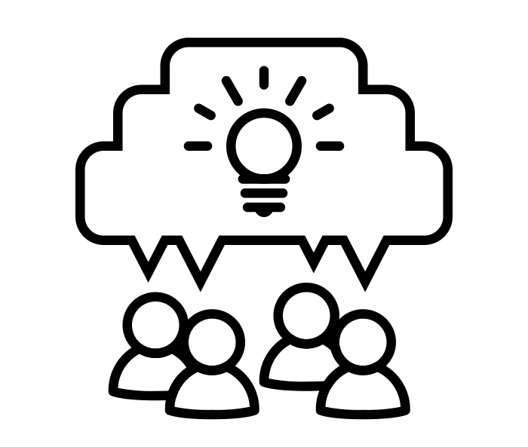
Open Science, what’s in it for you?
Facilitates collaboration between researchers ¹
BUT: takes time, coordination, and infrastructure
More efficient development of methodology ²
BUT: fear of scooping, IPRs
Increased citations and impact of research ³ ⁴
BUT: APCs may be costly
Faster dissemination of research ⁵ ⁶
BUT: speed must not compromise quality
Improved reproducibility of data ⁷
BUT: takes time without much recognition
Image Collaboration by Roberto Chiaveri Noun Project CC-BY 3.0
Notes:
Collaboration: For open science to foster collaboration, we can benefit from using agreed upon data structures, vocabularies, and metadata standards that allow both researchers and machines to easily integrate various open datasets and analyze them (i.e., they would be interoperable). Genomics and molecular biology provide strong examples of this standardization and associated interoperability. The creation of large databases such as GenBank and UniProt have led to gene and protein sequence data being deposited in a common format. This standardization fueled a revolution in bioinformatics, allowing large-scale analysis at the touch of a button [84–87].
But: Collaboration takes time, coordination, and often requires infrastructure or support that isn’t always available—especially across borders or disciplines.
Development of methodology: We argue that the disclosure of more, valuable R&D work in quality scholarly publications and collaborations with academic partners positively affect firm innovation. We further hypothesize a differential effect of adopting open science strategies on the innovation type, being more pronounced for radical innovations than for incremental innovations.
But: Sharing methods early or openly can lead to fear of being "scooped" or having work reused without credit (especially in competitive fields).
Impact: Open access also promotes greater visibility and impact for individual researchers. Studies have shown that open-access articles are cited more frequently than those published behind paywalls (Eysenbach, 2006, Gargouri et al., 2010; Teplitskiy et al., 2017).
But: Citation benefits vary by discipline, and open publishing may involve costly APCs (article processing charges) that not all researchers can afford.
Faster dissemination: Beyond, open access journals often have shorter publication times, allowing researchers to share their findings more quickly.
But: Speed can compromise quality control if peer review is bypassed or not rigorous (e.g. through preprints without community curation).
Improved reproducibility: for many current scientific fields, claimed research findings may often be simply accurate measures of the prevailing bias. Bias can be reduced by study pre-registration
But: Making data reusable takes extra time and effort (cleaning, documentation, licensing), often with little reward or recognition in traditional academic evaluation.

Slide 26
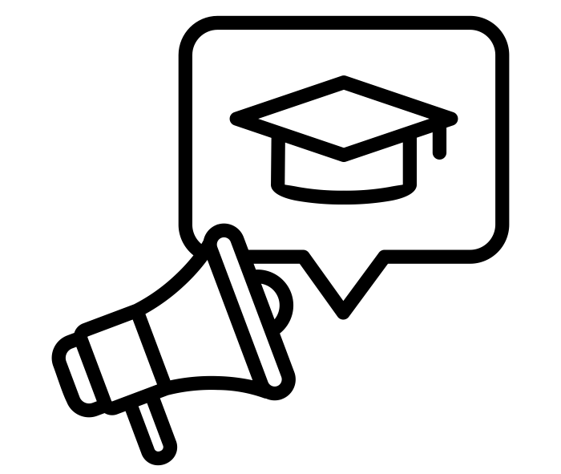
Open Science, what’s in it for you?
Helps ECRs build visibility
BUT: confusing without proper education
Aligns with funder/institutional mandates
BUT: burdensome without proper support
Better utilisation of public funding ¹
BUT: burden falls on researcher
Increased public awareness and interest ²
BUT: non-experts can misuse/misinterpret open data
Image Educational campaign by Good Father Noun Project CC-BY 3.0
Notes:
Helps early-career researchers build visibility
But: They may also be more vulnerable to misuse of open work or face uncertainty around norms for credit and authorship
Aligns with funder and institutional mandates
But: Mandates may feel burdensome if support (like repositories, data stewards) isn’t provided.
Utilisation of public funding: Taxpayer funded research should be available for all. Stockholms universitets centrala stöd för öppen tillgång administreras av universitetsbiblioteket. Biblioteket betalar dels för vetenskapliga artiklar publicerade inom förlagsavtal och dels för artiklar i helt öppet tillgängliga tidskrifter. Stockholms universitets kostnader för öppen tillgång 2023 är 28 903 123 kr. 2023 publicerades 90% av alla artiklar med en ”corresponding author” från SU med öppen tillgång.
But: The burden of openness often falls on individual researchers or institutions without corresponding funding or infrastructure. This can result in increased workload, compliance pressure, and inequities between well-resourced and under-resourced researchers or countries.
Increased public awareness and interest: the vast majority provided evidence of the societal impact of Citizen Science (163 papers, 83.2% of OS type instances; figure 2), across a wide variety of types of societal impact (figure 3). Twenty-eight papers demonstrated the societal impact of OA, with impacts including public engagement with scientific literature, use in policy-making, and health-related outcomes. We identified three papers that speak to the impacts of OS in general and two that demonstrate the public health impacts of Open Code/Software.
Education and awareness (112 or 57.1% of papers) and climate and environment (96 or 49.0% of papers) were by far the most commonly evidenced types of impact within our data.
But: Open data can be misinterpreted or misused by non-experts or bad actors.

Slide 27
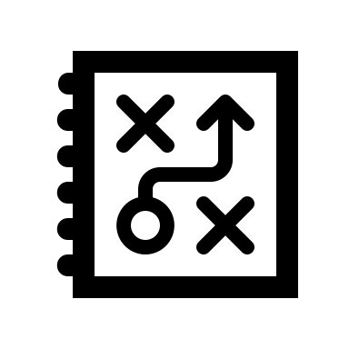

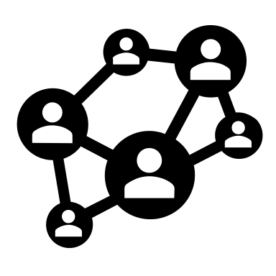
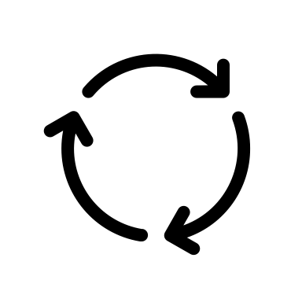


Open Science, what’s in it for you?
Typical research project flow
Plan &
Design
Collect &
Analyse
Publish &
Spread
Access &
Reuse
Evaluate &
Build
Communicate & Involve
Notes:
15min exercise: Students walk around the room and go and stand with the part of the research project flow that they feel answers the question best:

Slide 28
Open Science, what’s in it for you?
Typical research project flow
Plan &
Design
Collect &
Analyse
Publish &
Spread
Access &
Reuse
Evaluate &
Build
Communicate & Involve
Where in your project do you already do something that could be called Open Science?
Notes:
15min exercise: Students walk around the room and go and stand with the part of the research project flow that they feel answers the question best:

Slide 29
Open Science, what’s in it for you?
Typical research project flow
Plan &
Design
Collect &
Analyse
Publish &
Spread
Access &
Reuse
Evaluate &
Build
Communicate & Involve
Where do you see the biggest opportunity to be more open?
Notes:
15min exercise: Students walk around the room and go and stand with the part of the research project flow that they feel answers the question best:

Slide 30
Open Science, what’s in it for you?
Typical research project flow
Plan &
Design
Collect &
Analyse
Publish &
Spread
Access &
Reuse
Evaluate &
Build
Communicate & Involve
Where do you see the biggest barrier?
Notes:
15min exercise: Students walk around the room and go and stand with the part of the research project flow that they feel answers the question best:

Slide 31

Leg stretcher
5 min

